Slide 1
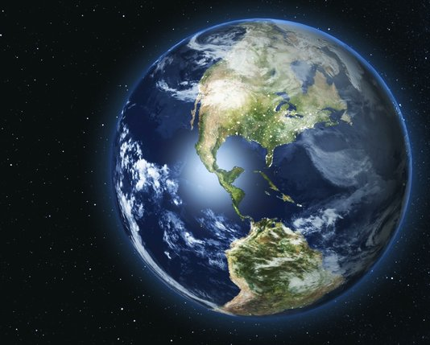
IMMC
MANUREWA HIGH SCHOOL

Slide 2
“
What is the Earth’s carrying capacity for human life?

Slide 3
ASSUMPTIONS
Quality of life – “sustain indefinitely” is defined without respect for living conditions
Average consumption – all people consume the average amount of resources, as stated in literature
All data is accurate – the literature sourced in our report is reliable
Same proportion of consumption – as the population swells, quantities of consumption remain proportionate
Plant and phytoplankton life can be sustained – the oxygen produced from these sources remains sustainable
Even global distribution of resources – resources can be efficiently transported to where they are needed

Slide 4

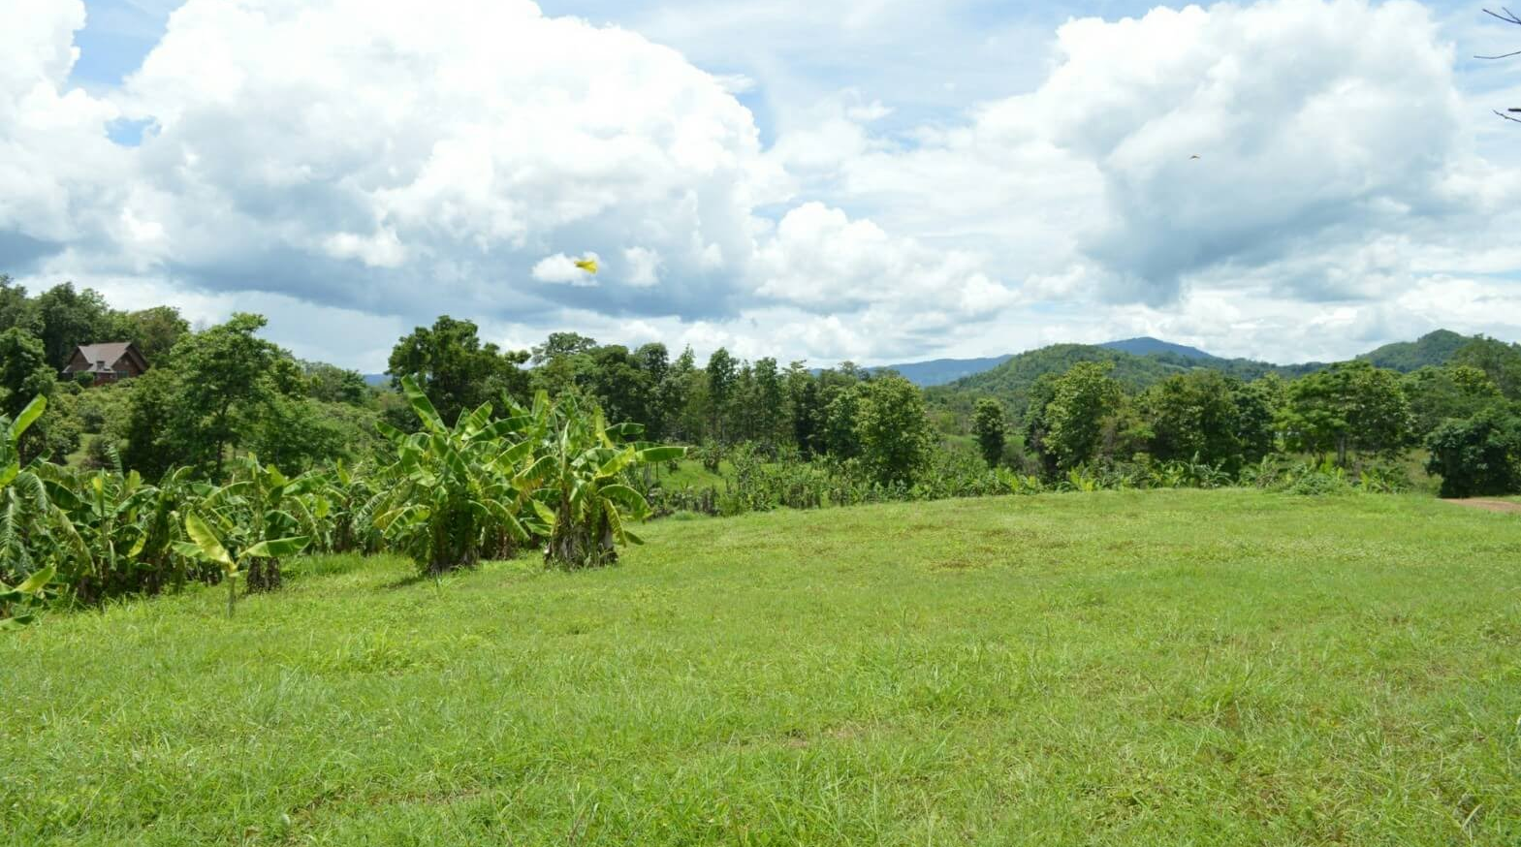
Limiting factors

Slide 5
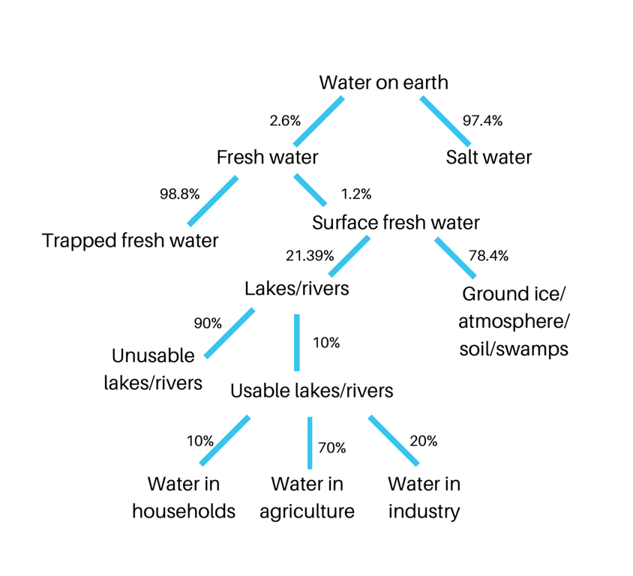

Water

Slide 6
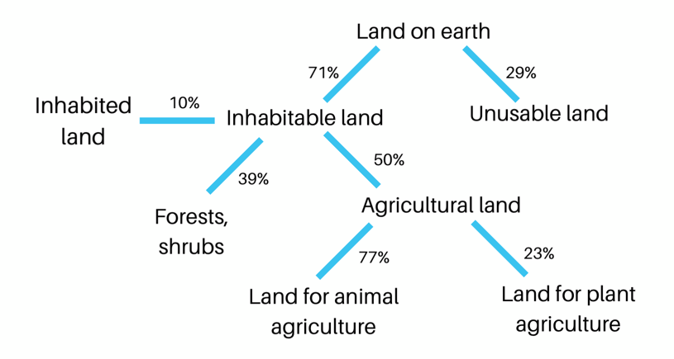
Land

Slide 7

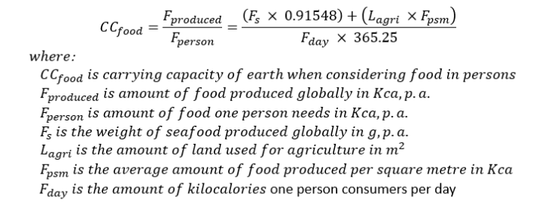
Food

Slide 8
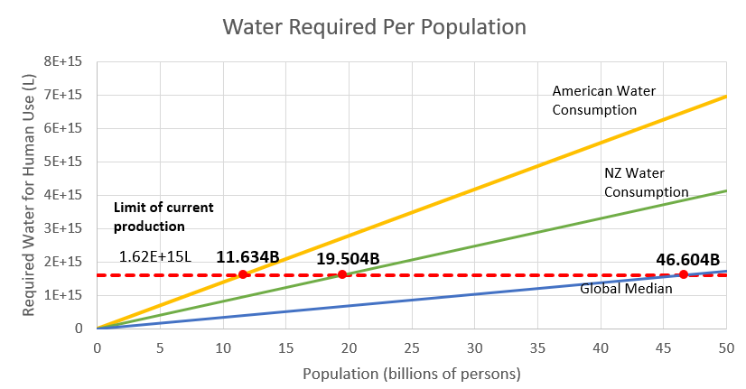

OUR MODEL
$$Water Needed ∝Population$$
$$Water Needed Per Person Per Year$$
139000 L /person /yr
83000 L /person /yr
35000 L /person /yr

Slide 9
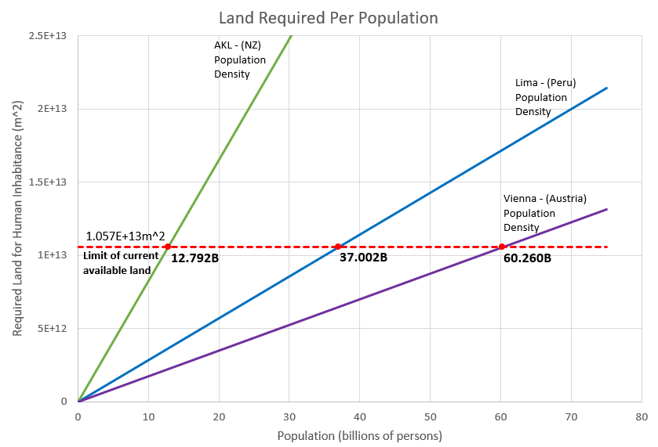
OUR MODEL
826 m² /person /yr
286 m² /person /yr
175 m² /person /yr

Slide 10
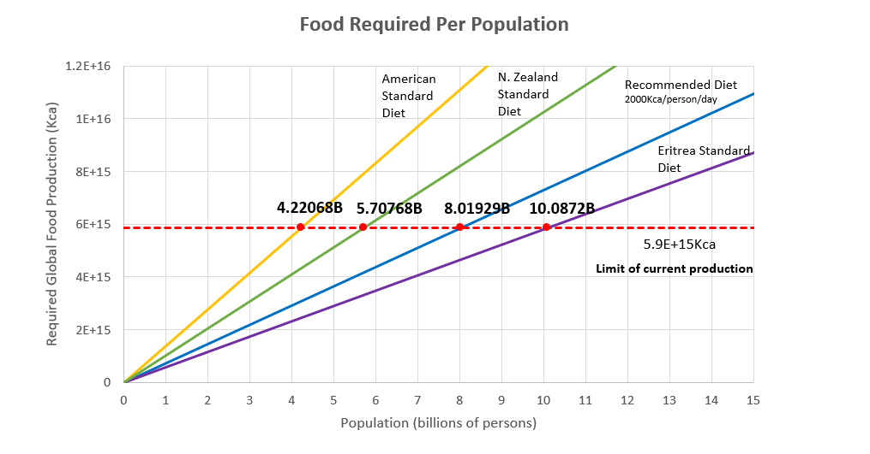
OUR MODEL
1400000 Kca /person /yr
1000000 Kca /person /yr
730000 Kca /person /yr
580000 Kca /person /yr
Recommended Diet
5.9 E+15 Kca
8.02 Billion
2024

Slide 11
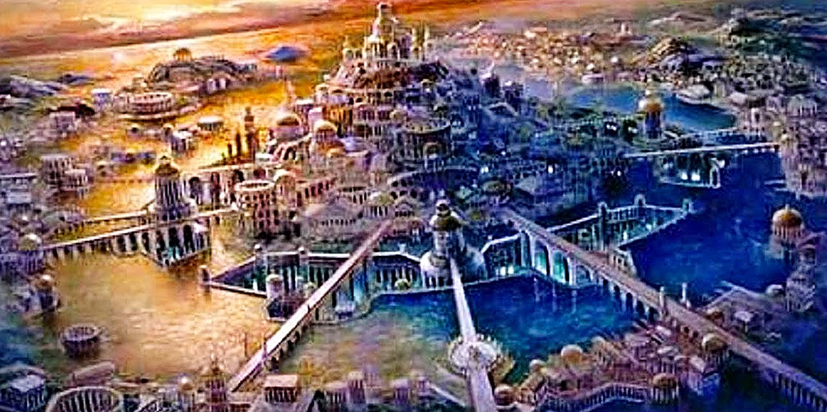
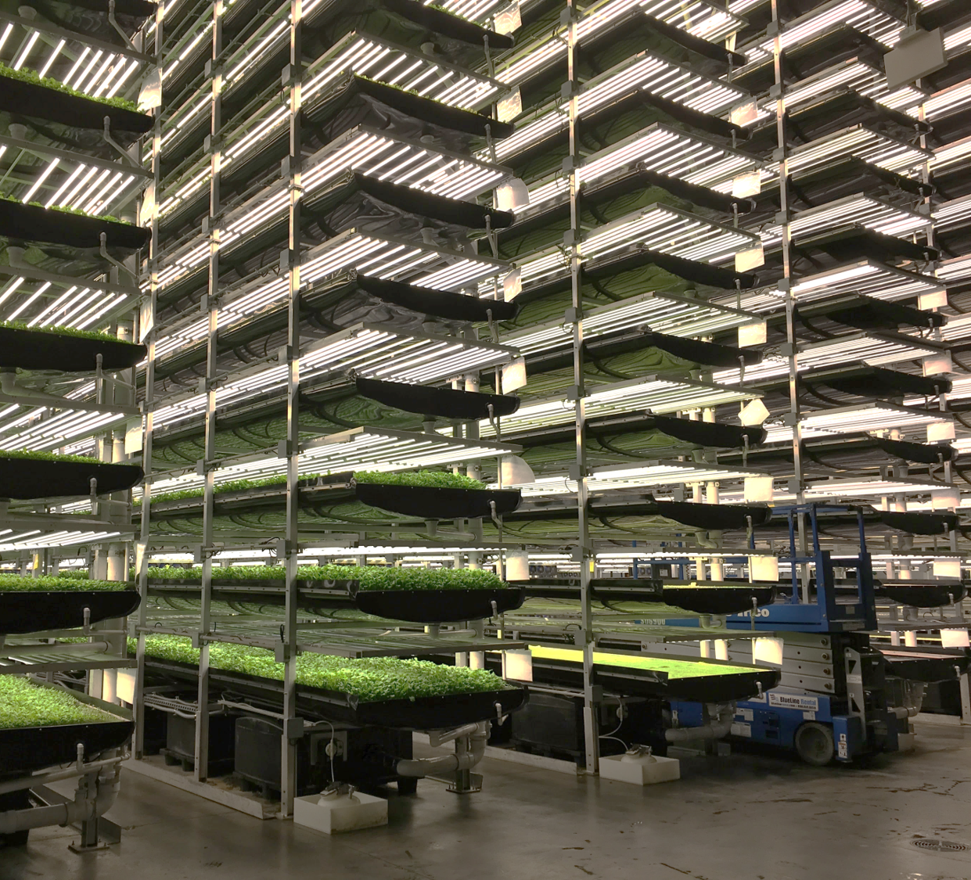
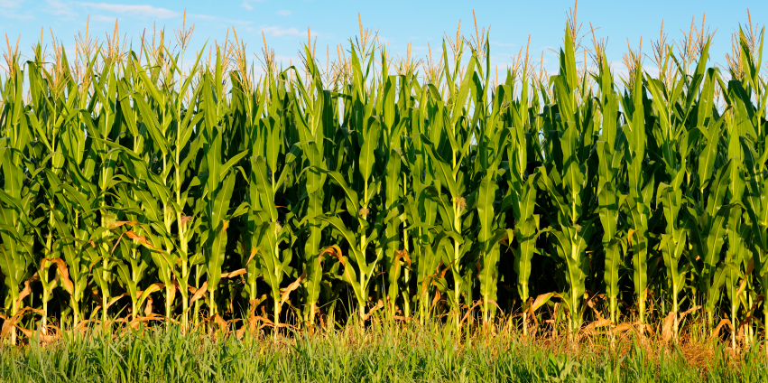
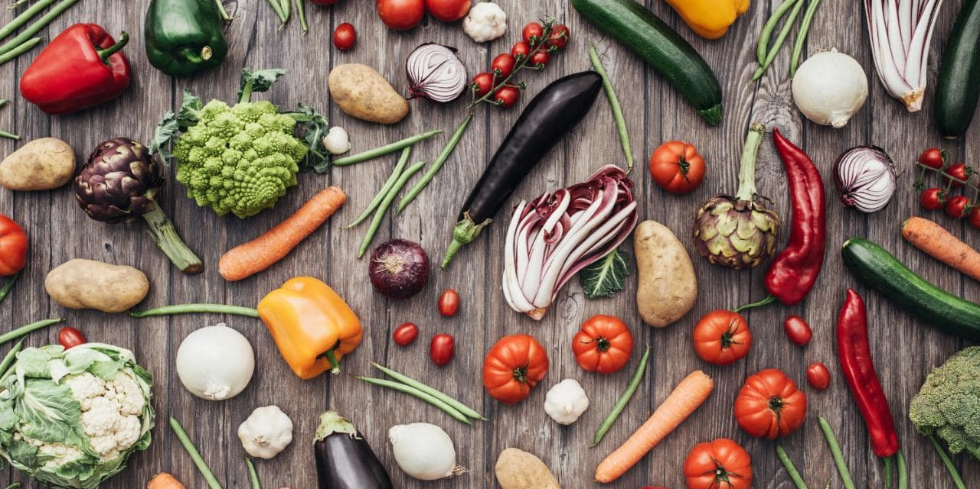
IMPROVEMENTS
PART THREE:
What can mankind realistically do to raise the carrying capacity of the Earth for human life in perceived or anticipated future conditions? What would those conditions be?

Slide 12
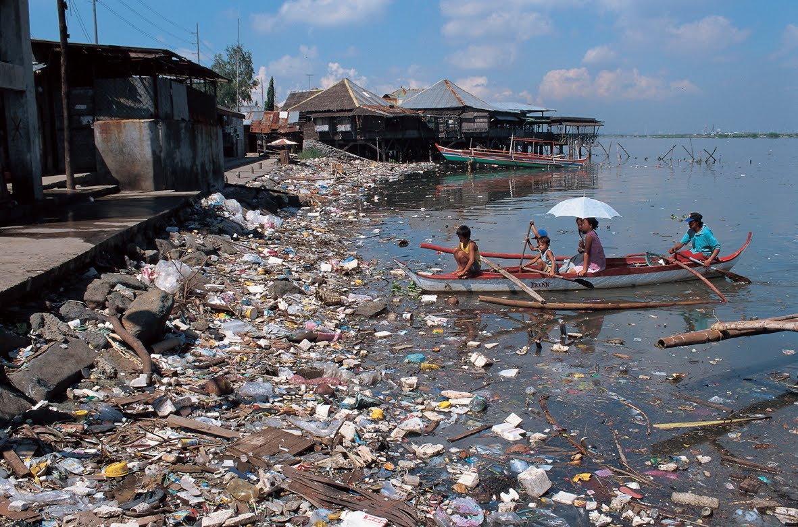
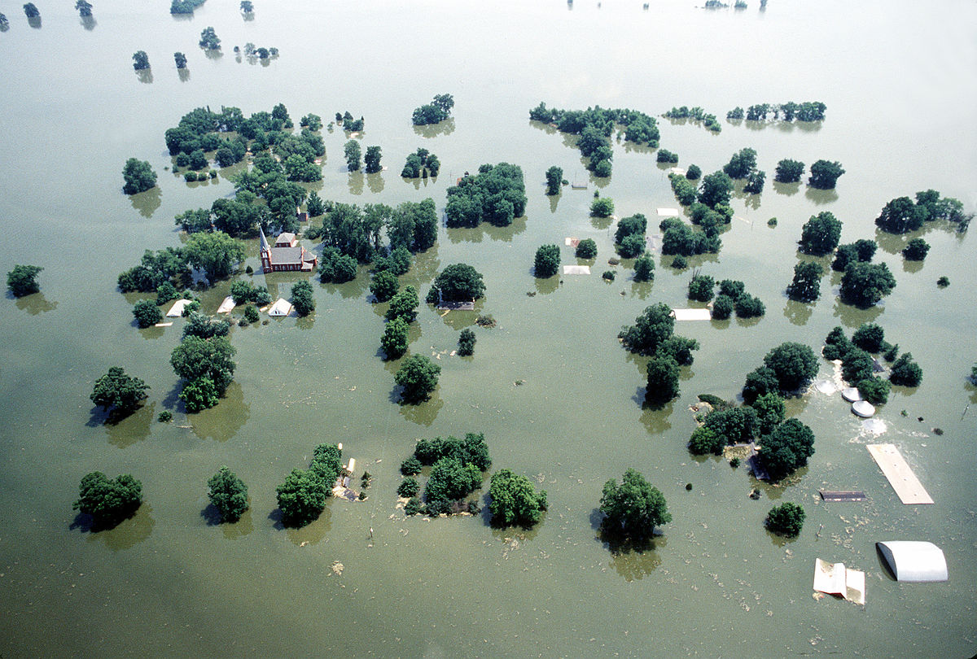
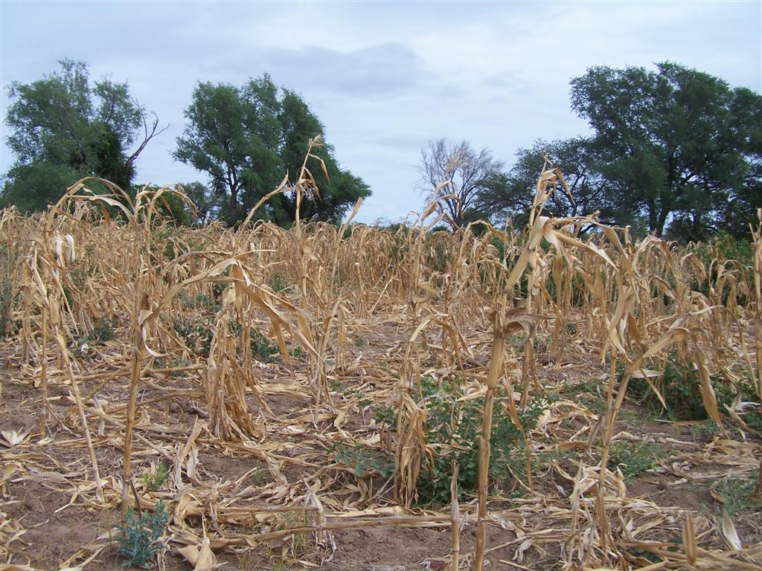
Future conditions affecting carrying capacity
POLLUTION | CLIMATE CHANGE | DEFORESTATION
LAND
Climate Change (rising sea levels)
Deforestation (agricultural land becomes arid)
WATER
Pollution (acid rain, contaminated waterways)
Climate Change (melting ice reserves, droughts)
FOOD
Pollution (contaminated seafood)
Climate Change (longer dry seasons, pests, spread of disease)

Slide 13
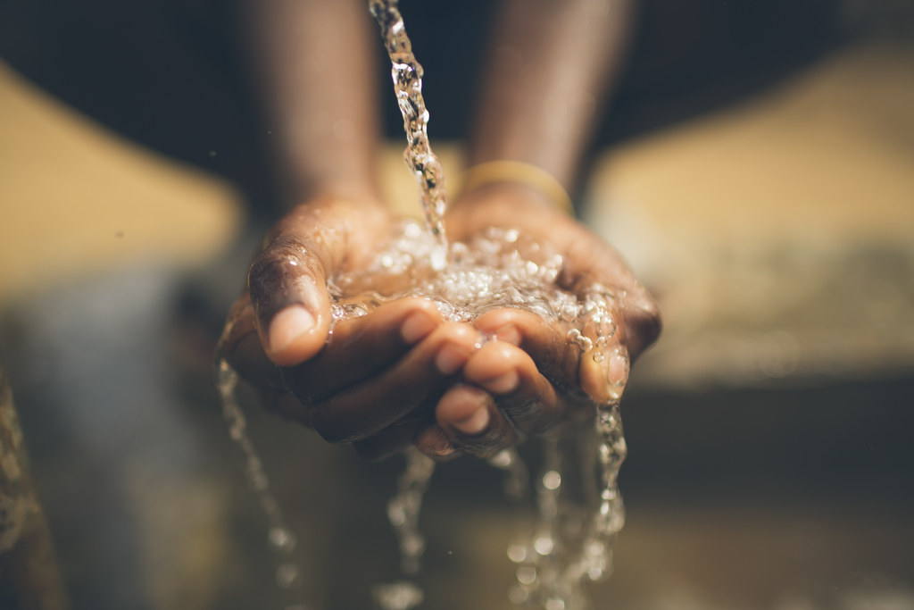
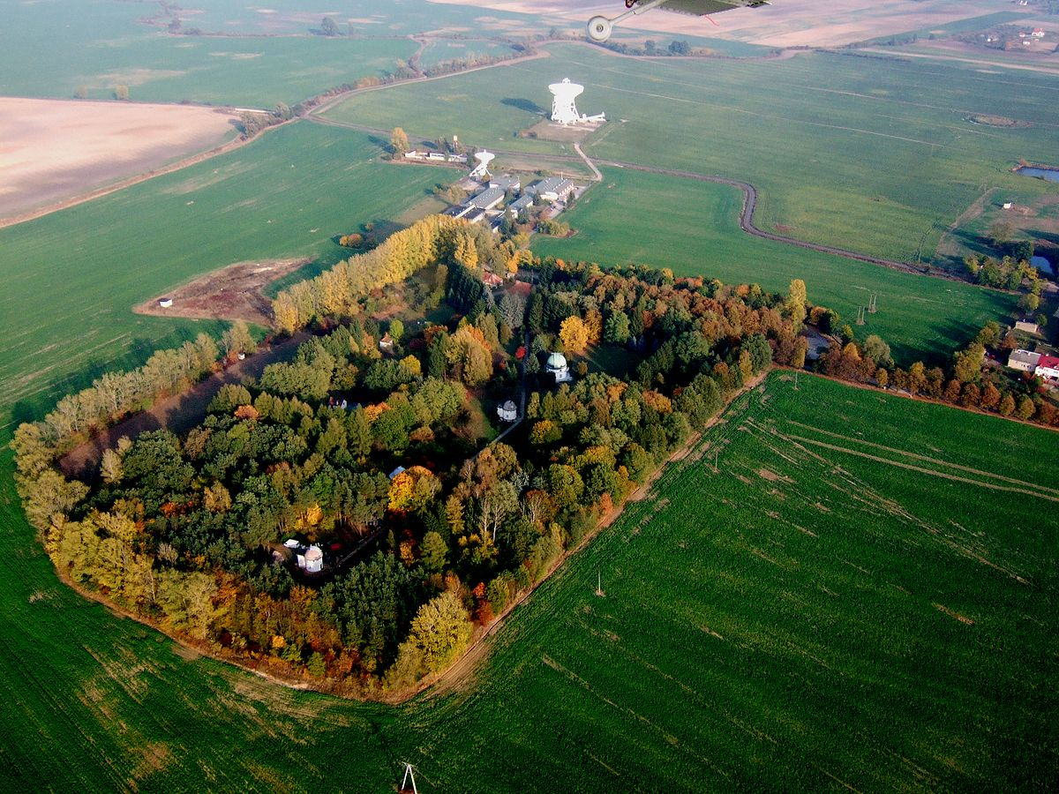
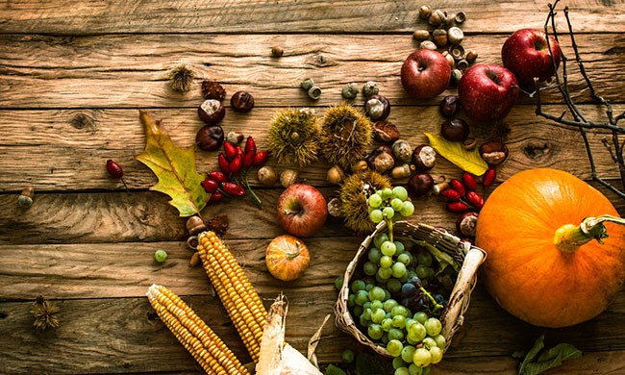
WHAT CAN WE DO?
BEING MORE EFFICIENT WITH THE RESOURCES AND TECHNOLOGY WE HAVE
WATER
Improving infrastructure (treatment, storage, supply, hydropower)
Collecting freshwater (desalination, rainwater)
Water conservation
Reducing pollution
LAND
Building upwards (reducing urban sprawl, vertical farms)
Eating less meat
FOOD
Genetically modified crops
Stop food waste
Better energy sources
Eating less meat

Slide 14
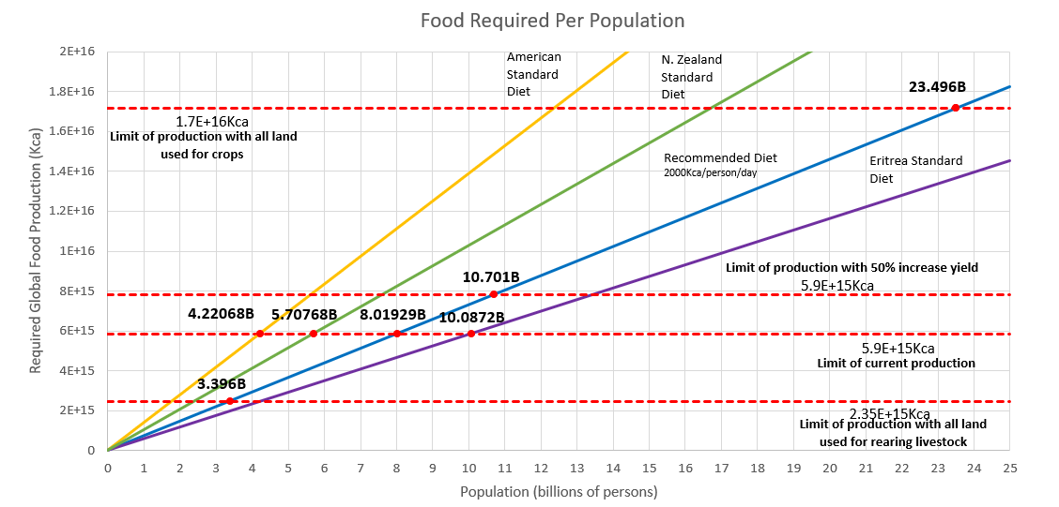

Slide 15




ACKNOWLEDGEMENTS
Manurewa High School
Auckland University of Technology
IOC of IMMC

Slide 16
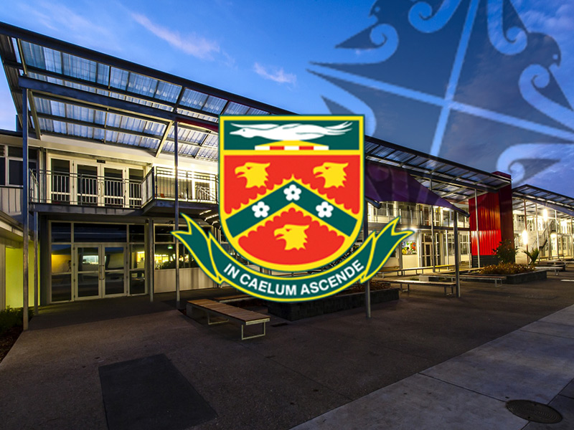

PIKI ATU
Piki atu ki te rangi
Te whakatauaki o te kura
Kake atu ki te Ariki
Te aroha kore mutunga
Kohikohia nga taonga
Mo nga kete o te wananga
Tuatea tua uri
Aronui na tane e
Puritia, nga matauranga o nga tipuna
Puritia Mo ake tonu atu e
Puritia, nga matauranga o nga tipuna
Puritia Mo ake tonu atu e
Aim for the narthex of the sky
Akin to the motto of the school
Ascend towards the lord
Everlasting love
Collect all the treasures
From the baskets of the learning institutions
Tane who ascended through the heavens
To collect the baskets of knowledge
Hold fast to the knowledge of the ancestors
Hold fast for evermore
Hold fast to the knowledge of the ancestors
Hold fast for evermore

